Slide 1
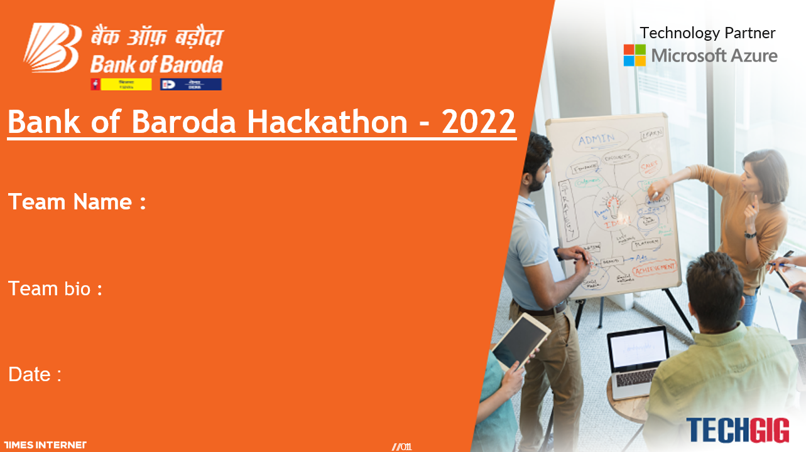
House Of The Dragon
The only thing that could tear down the House Of The Dragon was itself
18-09-2022

Slide 2
PROBLEM STATEMENT
Bank handles large volumes of cheques in the clearing process. The process involves many technical verifications including signature verification. Some of these steps are manual and require human intervention to complete the process. The current process requires the high human capital deployment and longer processing.
CONSTRAINTS
Automation of the clearing process using AI/ML/ICR/OCR techniques
Automatic Data Entry & Technical verification
Signature Verification
Support Multilingual
Reduce Human Efforts
Reduce Processing time
Detecting Potential Frauds

Slide 3
REASON BEHIND CHOOSING THE STATEMENT:
Out of all the problem statements, this seemed the most challenging because of the shear human labor involved to process a cheque and the time taken to sanction it.
It is said that it takes about 3 working days to process a cheque, i.e. 72 hours for a single transaction which is tedious and unreliable in case of emergencies.
Also, banks receives colossal amount of cheques every day. Since it is man powered, it is prone to human errors which can increase the chances of valid cheques getting rejected.
These drawbacks urged us to take this problem statement.

Slide 4
USER SEGMENT & PAIN POINTS:
Any bank(s) which is still stuck with the conventional method of processing cheque can adopt this system for better handling/processing of cheques.
The conventional process is time consuming.
To minimize human errors.
For the betterment of bank-customer relation.
Processing cost.

Slide 5
PRE-REQUISITE
A cheque written by the drawer is required by the payee which is to be submitted in the payee’s bank.
A challan should be filled by the payee to verify his/her details.
A device is required with a basic computational power that supports and runs this software for image processing.
An automated server is required to respond to the client’s request.
ALTERNATIVES
One of the alternative is the use of cheque processing machines where cheques are put in a machine which scans and retrieves the handwritten information.
Other alternative for this problem statement could be the solution that we have provided i.e., a software for cheque image processing where the information are processed through a client-server model and transactions are done completely virtually without human intervention.

Slide 6
MICROSOFT TOOLS USED
Visual Studio Code
Microsoft Access
Microsoft PowerPoint
Microsoft OneNote
Microsoft Visio
Github
OTHER TOOLS USED
Jupyter Notebook
PyTesseract
OpenCV
Pillow
Python

Slide 7
OUR SOLUTION
The drawer issues the cheque to the payee
The payee takes the cheque to his/her bank to process it
The payee’s bank rep. validates the cheque manually. Validates for any anomalies (physical tampering)
The cheque is given to the developed software in the form of either a jpeg, png, a doc or even as a pdf file.
The given check is preprocessed, and compared with the dataset of various handwriting already given as datasets.
The account number, the MICR code, the amount and the signature are retrieved from the cheque and stored in a JSON file.
Now this file is encrypted and sent to the drawer’s bank to verify the drawer’s details (This happens only if the drawer writes a cheque of another bank).
The file is decrypted on the server side (drawer bank’s database) to verify the account number, the MICR code, the amount and only if all of these information are verified, only then the signature matching takes place.
Even if any one of the above details does not match with the database, the cheque is bounced.
If all the details are successfully verified, then money or the fund is sent by the server to the client (the payee’s bank) and the client can complete the transaction.

Slide 8
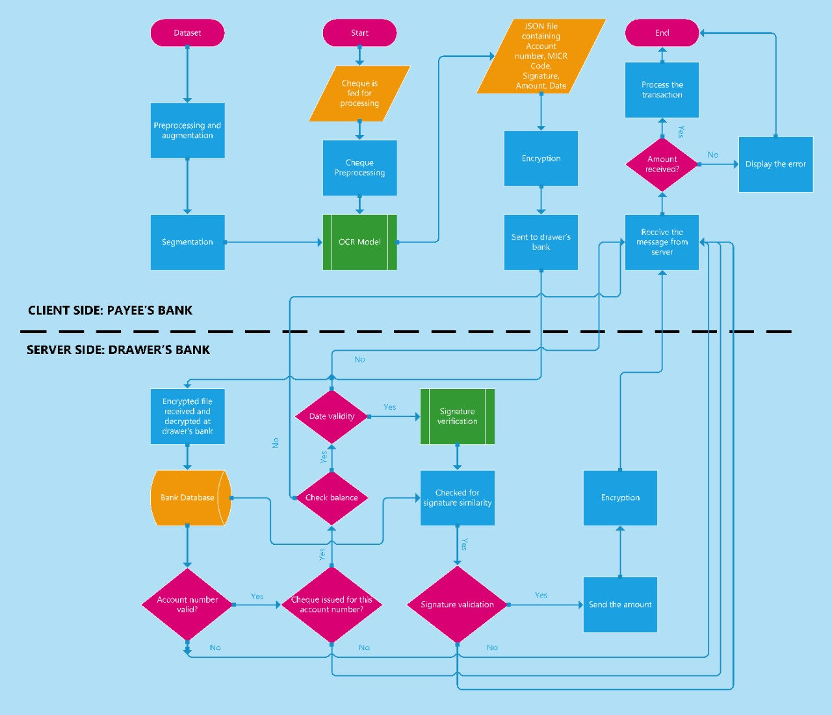

Slide 9
KEY DIFFERENTIATORS
This software solution to the cheque validation and clearing process is much more effective than the traditional methods which is time consuming and requires tremendous amount of man power. Since the current/alternate method also is prone to human errors, this model almost overcomes that.
The other alternative of cheque processing is through cheque processing machines. Even though cheque processing machines are much more effective than the traditional way of cheque processing, it is still a very costly method. Since these machines are very costly, the bank has limited number of these machines.

Slide 10
ADOPTION PLAN
Our solution to cheque processing can be adopted by banks very easily. They just need a device with an average camera quality to scan the cheques clearly. Banks who still spend a lot of time to process cheques makes emergency transactions get delayed which ultimately affects bank-customer relation. Therefore there is a distance between the customer and the bank we tend to lose many customers so we are influencing with our solution which can reduce the loss of clients and enhance the bank with our greater technology with most convenient usage of our bank.

Slide 11


Slide 12
OUR TEAM
HARIRAM S (Team Leader)
HARIKRISHNAN D (Team Member)
CHARAN VIGNESH NR (Team Member)
DINESH BABU S (Team Member)
TEAM MENTOR
Ms. KRIPA SEKARAN

